Slide 1
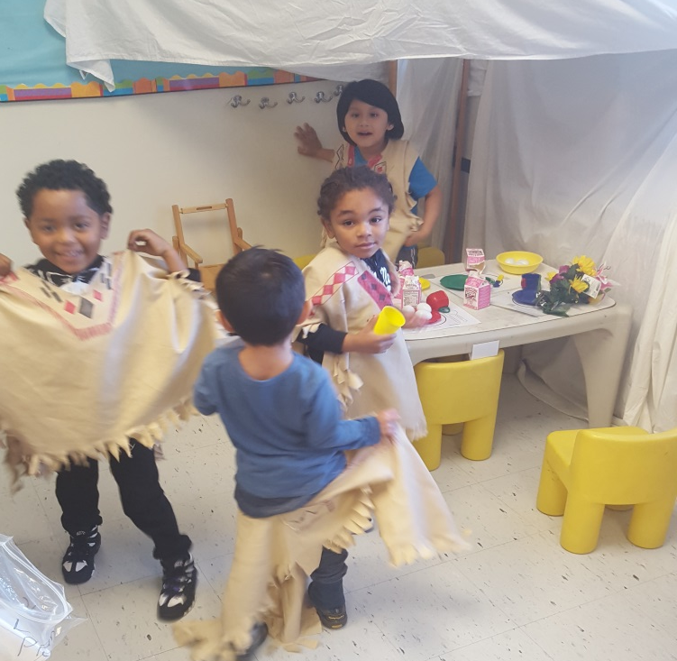
Superintendent’s Report Dr. David Fine Peekskill City School District: A System Focused on Every Student; Every Day.
Meeting of the Board of Education
December 15, 2015

Slide 2
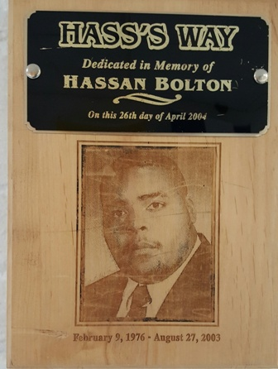
Hass’s Way
Hassan was a Peekskill Student and Security Guard at Park Street. Friend and Mentor to many. His mom donated $5,000 to the program for updates, materials, resources, for the students, staff, and program.

Slide 3
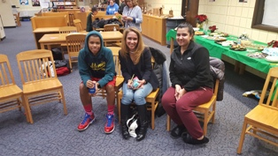
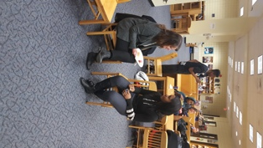
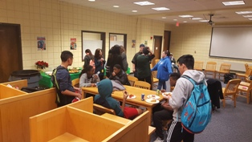
Smart Start Mentoring Program at PHS

Slide 4
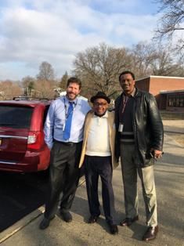
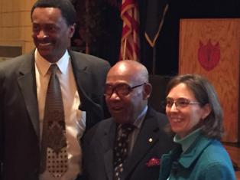
Charles Potter --Houston to Peekskill-- Financial Aid, Plus…

Slide 5
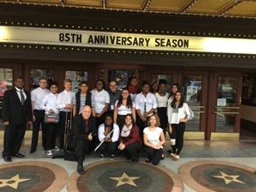
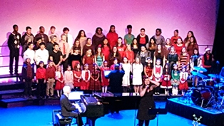
Paramount: David Benoit and the Peekskill Choir

Slide 6
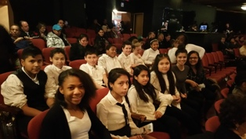
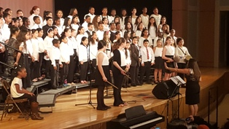
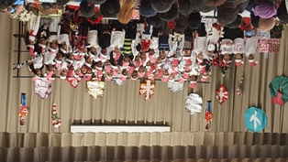
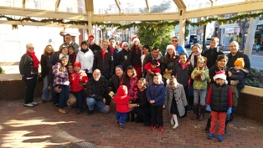
Chamber Choir; Hillcrest; Woodside; and the Caroling

Slide 7
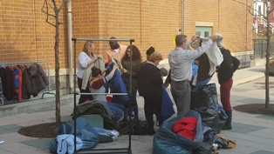
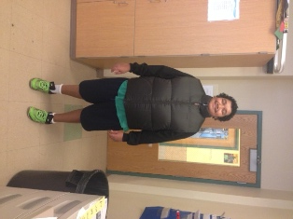
Coat Drive Thank You Jackie Kilanowski and Entergy

Slide 8
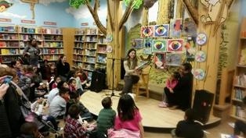
Oakside at Barnes & Noble

Slide 9
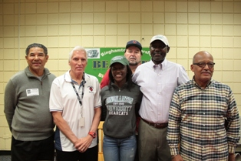
Chelsea Ogindo: So Proud!

Slide 10
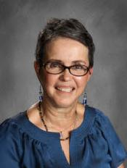
Congratulations to Myrna Santos on being the recipient of the Community Service Award sponsored by The Preservation Company, Inc., which will be during the Dr. Martin Luther King, Jr. Celebration on Sunday, January 17, 2016 at 4pm.

Slide 11
Alumni Giving Back
Monday, December 21st • at 8:53–11:03 am in the Library
presentation by
Diana Barreto,
Peekskill High School, Class of 2015
Harvard, Class of 2019
Diana Barreto, a member of Harvard’s Hometown Ambassador Program, will be giving a presentation about life at Harvard College on December 21st, at 8:53–11:03 am in the Library. Diana’s goal is to make Harvard more accessible to high school students from her hometown by providing a sense of what it is like to be an undergraduate at Harvard. Topics discussed will include:
Harvard’s diverse academic opportunities
The unique aspects of student life at Harvard
Harvard’s generous need-based financial aid program
And more!
Notes:
TEMPLATE

Slide 12
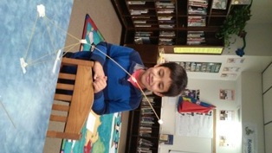
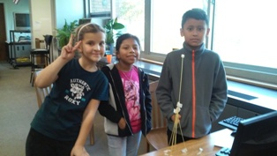
Enrichment
This class will combine literacy with science, technology, engineering and mathematic by applying the principles of STEM to solve problems faced by fairy tale characters. Students will hear the classis tales and then work in groups or partnerships to design and test out solutions for a posed problem. After reading Billy Goats Gruff for example, teams will design an amphibious craft that can carry the goats across land and the troll’s river. Instead of waiting for a prince to rescue her, students will help Rapunzel make a zip line to get her from the tower to the ground safely.
Through a bit of research and lots of hands-on, trial-and–error design and testing of prototypes, students will learn the basic principles of building structures, creating optimal animal habitats, drawing maps to scale and more.

Slide 13
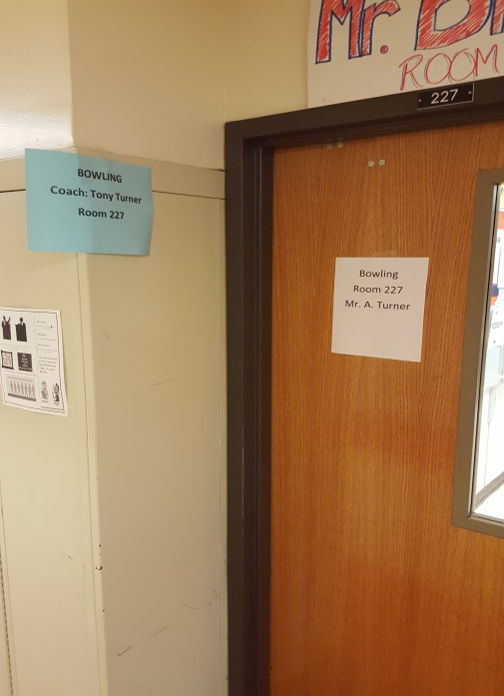
Top-Ten (10) Reasons Peekskill is a Wonderful Place to Live and Learn
10. Naviance System
9. Holiday Care and Comfort
8. Coat Drive (Leslie/Orfa)
7. Athletic Eligibility (Seasonal Meetings)
6. Hall of Fame Celebration
5. Safety and Security is Paramount
4. Building Condition Survey
3. Turkey Trots
2. Academic Growth and Chamber
1. Men’s Night

Slide 14
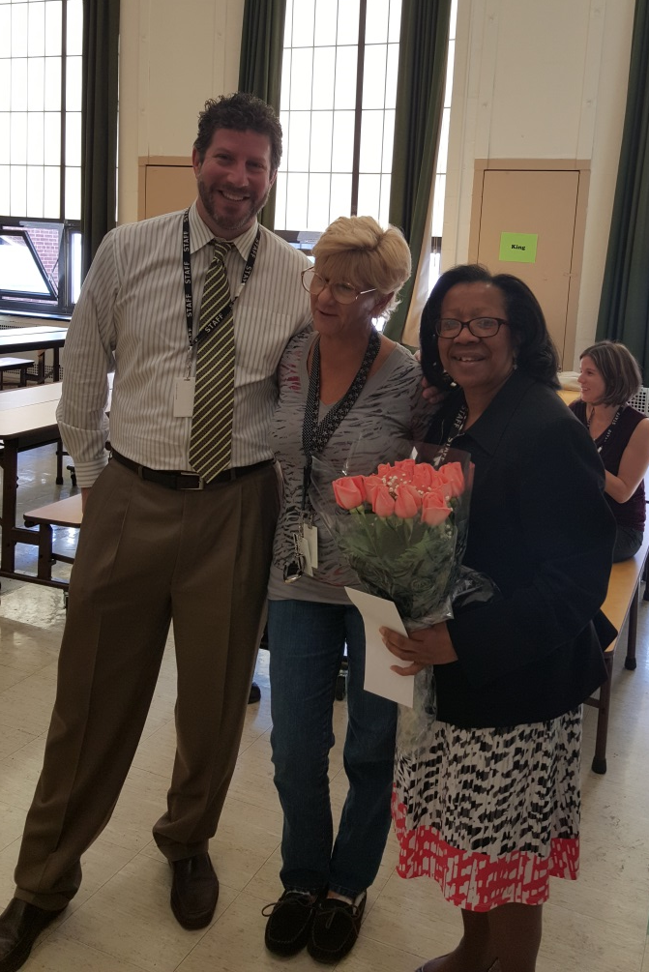
Thank You Ms. Lynn Riccio! You Are a Hero! Recognition and Proclamation

Slide 15
Upcoming Performances and Trips
December 17th- 2nd Grade Concert at Oakside at 1:30/High School Concert at 7
December 18th- 3rd Grade Concert at Oakside at 1:30
December 22nd- Middle School Concert at 7pm
4th Grade Chorus and Band- December 18th- Nutcracker Ballet (Westchester Ballet Company) at the County Center in White Plains
5th Grade Chorus and Band- January 21st-NY Philharmonic- Concert in honor of Jean Sibelius
7th and 8th Grade Chorus- January 20th- NY Philharmonic- Concert in honor of Jean Sibelius
7th and 8th Grade Band- June trip to Lake Compound for the High Notes Music Festival where the students will perform and be adjudicated.

Slide 16
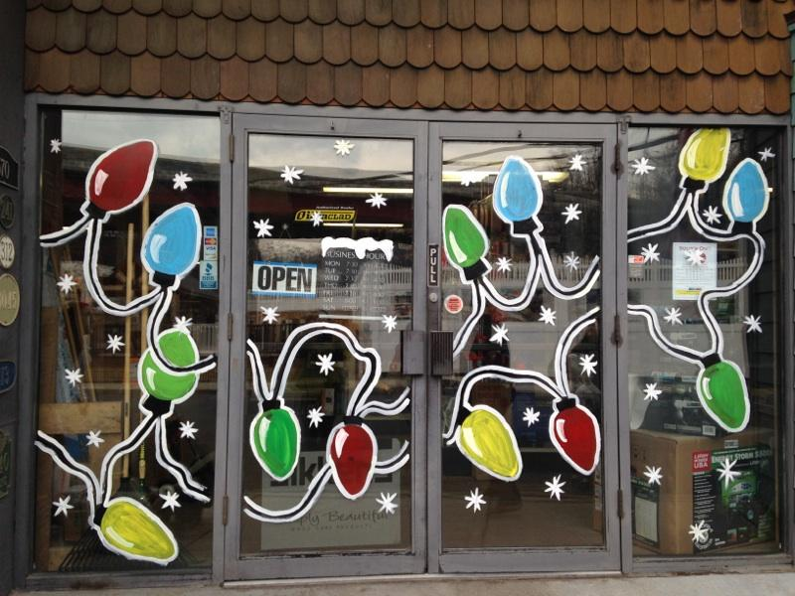
Student Council Report
Davonte Woodton Presenter – Postponed until January 19, 2016

Slide 17
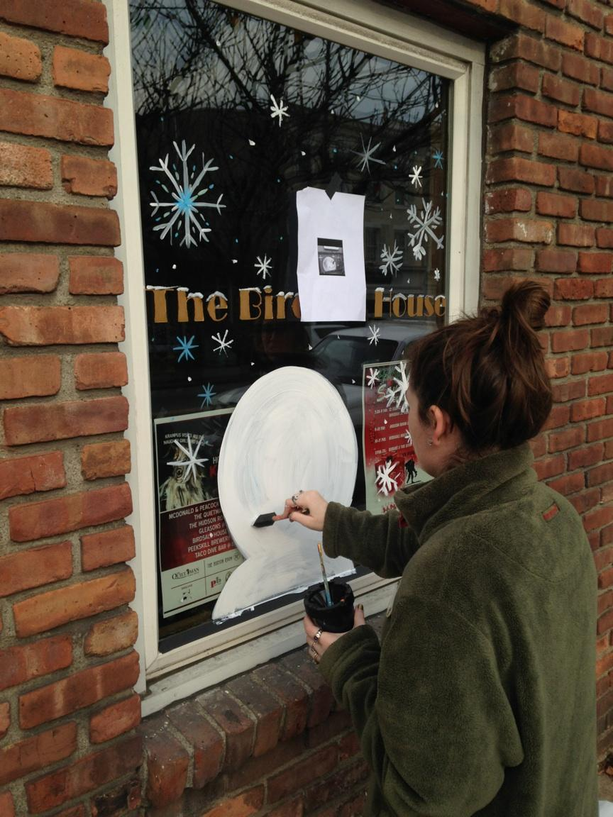
Educational Plan and Budget
Budget Framework: Workshop #2
Chamber and PCSD Arts: Window Decorating Contest

Slide 18
Contracts Under $10,000
Boy Scouts of America/Woodside, Oakside and Hillcrest Elementary; Provide the Scoutreach education program; 2015-2016 school year; $0 (facilities)
Donations/Grants Under $5,000
Scholastic, Inc./Peekskill Middle School students; Donation of books; Valued at $325.00
Ms. Sheila M. Roane/Summit Academy; Donation of $500.00

Slide 19
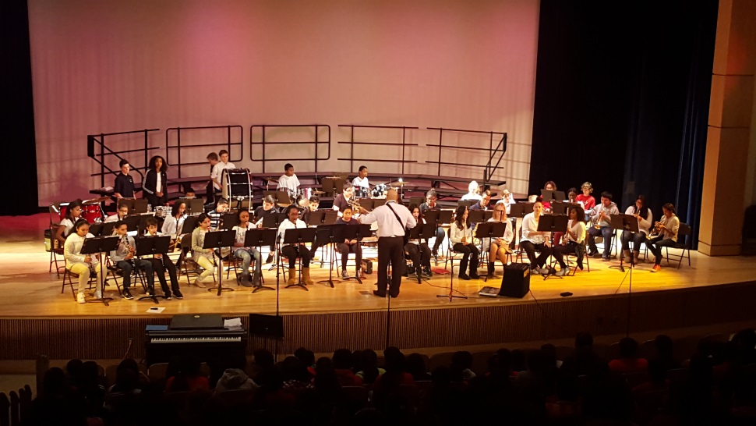
Thank You and Enjoy the Evening Have A Successful 2015-2016 School Year
*This Concludes the Superintendent’s Report
--Be Good to Yourself and Each Other--
“Be the Change you wish to see in the World.”
M. Ghandi

